Slide 1

Exploratory Data Analysis (EDA) on AMEO 2015

Slide 2
About me
I did Complete Bachelor of Technology .
The motivations for learning data science can vary from person to person, but it often involves a combination of intellectual curiosity, career aspirations, and the desire to make a positive impact .
I am currently working as a data science intern .
GitHub Link :
LinkedIn :
https://github.com/dadipavankumar118
https://www.linkedin.com/in/pavankumardadi/

Slide 3
Agenda
Objective of the Project : The objective of analyzing the salary payments for fresher in the company based on various features is to predict the appropriate salary range to offer to new hires.
Summary of the Data : The dataset includes various attributes related to employees and their salaries. Here are some key attributes that are typically found in such a dataset. Data set gives the information of Employees like Employee ID, Salary, Date Of Join, Date of Leaving, Designation, Job City , Gender, DOB, Educational Information etc.,
Exploratory Data Analysis:-
Data Cleaning Steps
Univariate Analysis
Bivariate Analysis
Business Problem
Conclusion (Key finding overall)

Slide 4
Data Cleaning steps:-
Handling Missing Values
Dealing with Duplicate Values
Finding Outliers
Removing columns which is doesn’t give relevant Information
Data Cleaning steps:-
Converting date columns to datetime format.
Creating new columns as age of employee , Experience .
Handling present values in “DOL” column with “12-31-2015” .

Slide 5
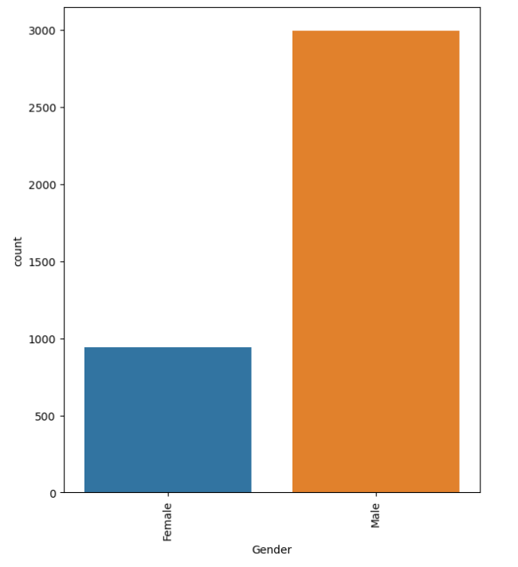
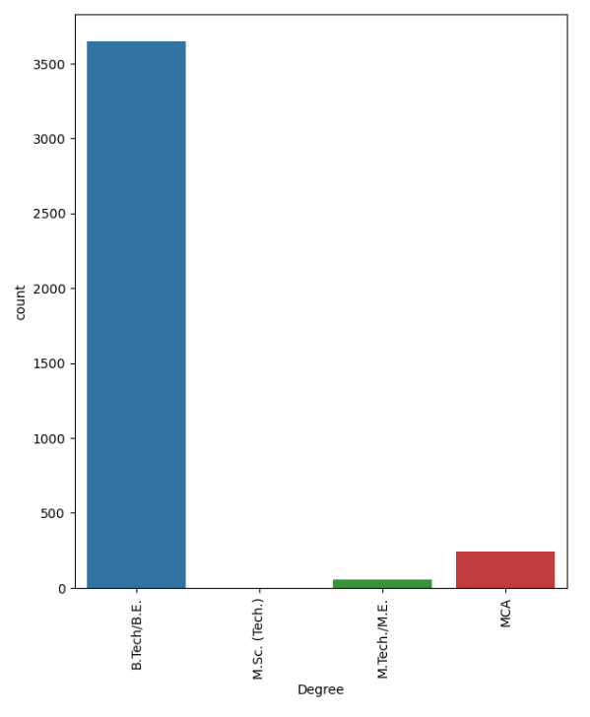
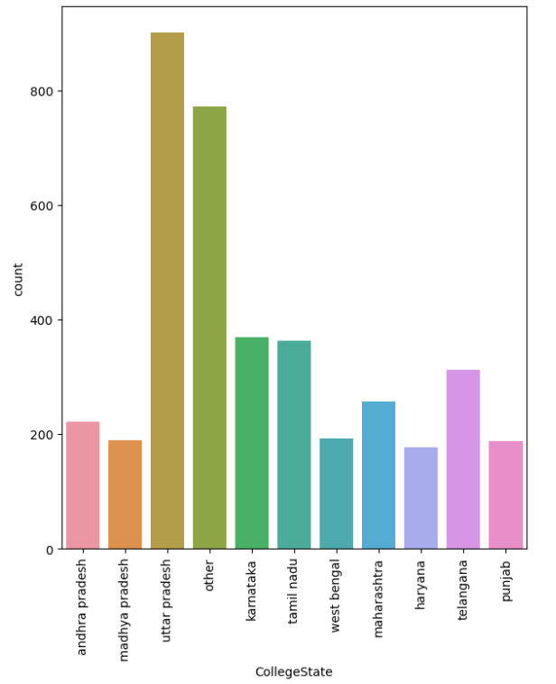
Univariate Analysis( Categorical ):-
In the dataset, the majority of employees are males, comprising nearly 3k members.
In the dataset, the majority of graduates are from BTech with over 3.5k graduates, while the fewest are from MSc(Tech). Therefore, based on this data, most students are opting for BTech.
In this dataset, most of the employees studied in Uttar Pradesh, with nearly 700 member.

Slide 6
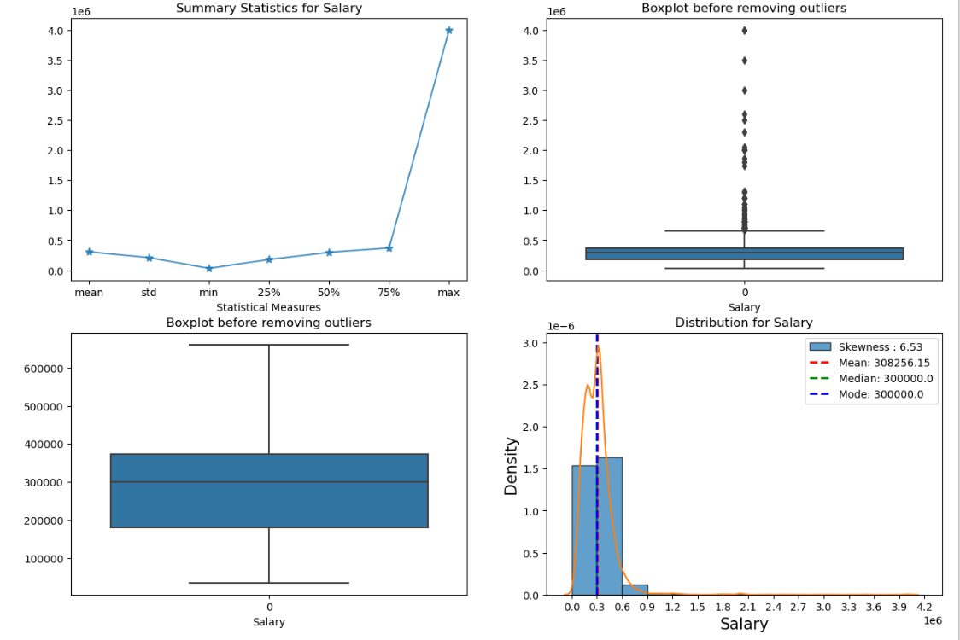
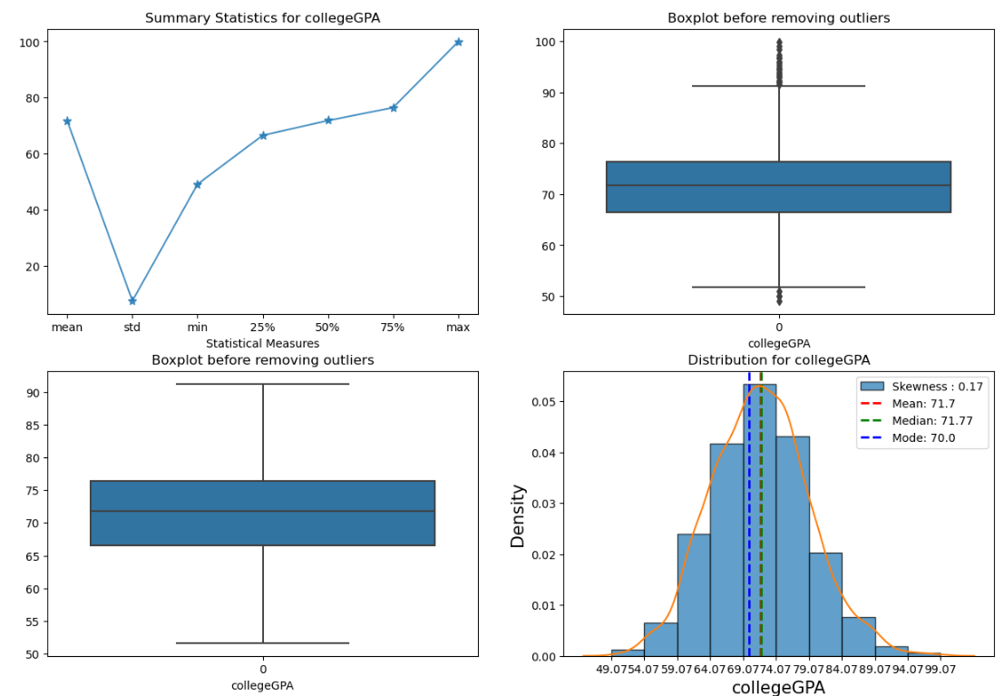
Univariate Analysis ( Numerical ):-
These columns contain outliers in salary(it exhibits a right skew), 10th percentage(left skewed), college GPA(both left and right skewed), English(right skewed), logical(left skewed), Quant(both left and right skewed) etc..

Slide 7
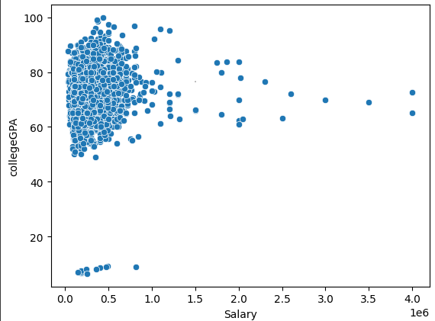
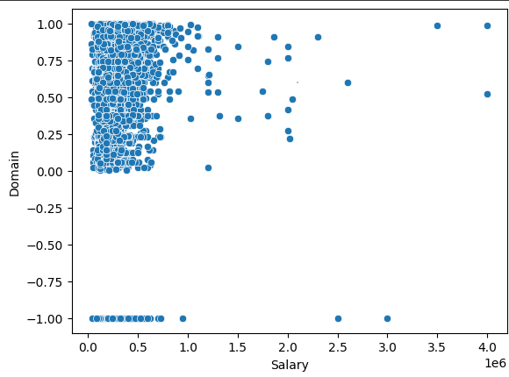
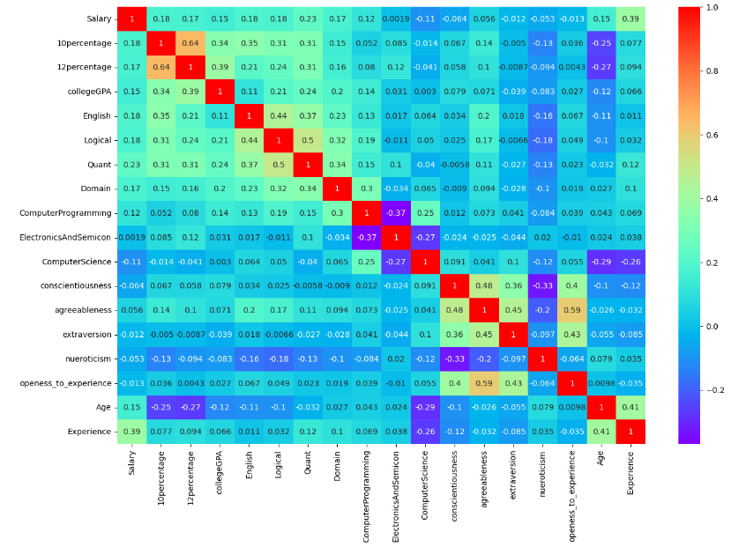
Bivariate Analysis (Numerical vs Numerical):-
Based on the first graph, it appears that for employees with college GPAs ranging from 6.0 to 9.0, the salary range is approximately between 2 to 5 lakhs. However, there are some employees whose salary falls between 5 to 10 lakhs.
Based on the second graph, for most employees who have a positive domain, the salary ranges between 1 to 6 lakhs. If the domain has a negative value, there are significantly fewer job opportunities.
Based on the first graph, there is no relationship between each column all numeric columns are independent columns.

Slide 8
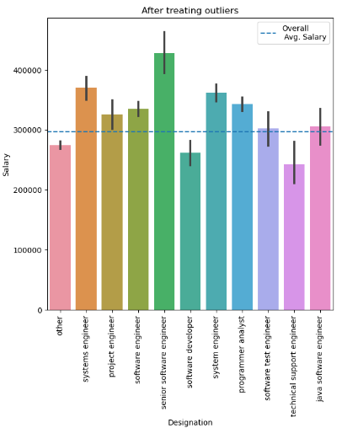
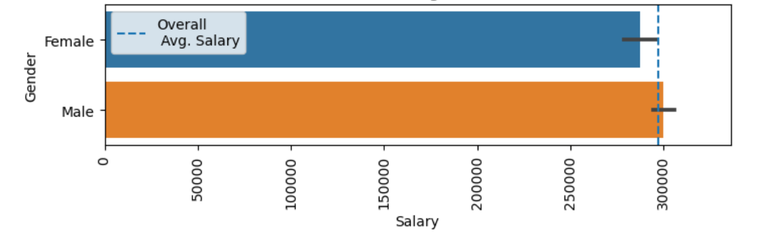
Bivariate Analysis (Categorical vs Numerical):-
The first graph indicates that it displays the average salary of each designation. When comparing the salary of the Senior Software Engineer designation with the remaining roles in the graph, it appears significantly higher.
The second graph displays average salary according to gender. The average salary for both male and female is approximately equal and it implies that there was no gender bias in terms of salary.

Slide 9
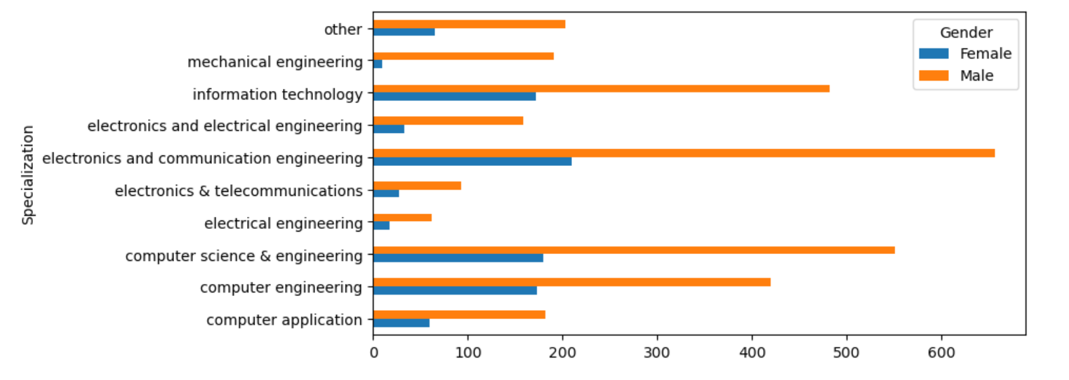
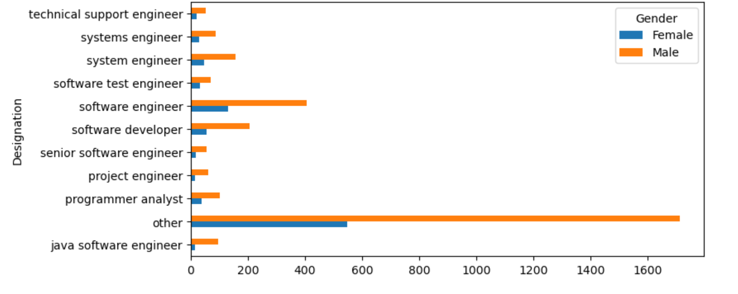
Bivariate Analysis (Categorical vs Categorical):-
The first graph illustrates the frequency distribution of gender across various specializations. Each bar represents a gender category, and the height of the bars indicates the frequency of each gender within the respective specialization. The graph is stacked to allow for a clear comparison of degree frequencies across different specializations. The x-axis represents the different degrees, the y-axis represents the frequency, and the title highlights the visualization's purpose: "Frequency of Gender by Specialization (stacked).
The second graph illustrates the frequency distribution of gender by designation, with data derived from a dataset. Each bar represents a gender category, stacked to indicate the distribution across designation. The x-axis denotes the degree, while the y-axis represents the frequency. This visualization offers insights into the gender distribution across various designation.

Slide 10
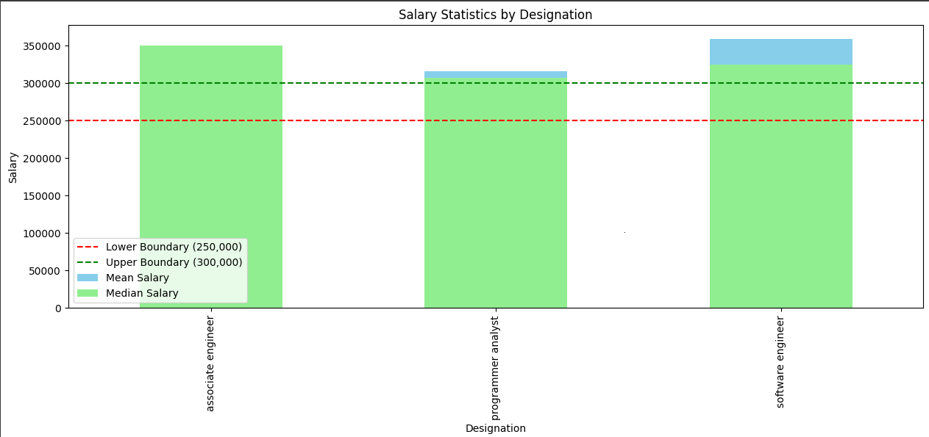
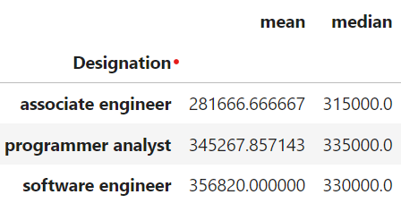
Business Problem:-
Bar plot illustrating the mean and median salaries for different designations. Two sets of bars are plotted: one representing the mean salary (colored sky blue) and the other representing the median salary (colored light green) for each designation. Additionally, horizontal dashed lines are added to denote the lower and upper boundaries set at 2,50,000 and 3,00,000 respectively.
This visualization helps in comparing the mean and median salaries across different designations and visually identifies whether salaries fall within the specified boundaries.

Slide 11
Conclusion:-
Finally, according to my analysis, this dataset represents data from employees primarily engaged in software-related jobs. Based on the research questions, I was unable to precisely address the problem statement. This is because fresher employees are receiving significantly lower salaries, and there is a moderate relationship between gender and specialization. Most of the male employees occupy higher-ranking positions, and they are often receiving more job opportunities as well.

Slide 12

THANK YOU

